Slide 1
Preferences for truth-Telling: Meta study
Johannes Abeler (Oxford)
Daniele Nosenzo (LISER & Nottingham)
Collin Raymond (Purdue)
You are welcome to use the graphs in any way (CC-BY license), as long as you cite: Abeler, Nosenzo, Raymond (2019) Preferences for Truth-Telling, Econometrica 87 (4), 1115–1153 An ungated version of the paper is available at: https://www.cesifo.org/DocDL/cesifo1_wp6087_0.pdf

Slide 2
Meta study of the Fischbacher/Föllmi-Heusi paradigm.
Document patterns in 90 studies using the Fischbacher/ Föllmi-Heusi (“FFH” 2013) paradigm
Subjects privately roll a die or a flip a coin and then report outcome
Material payoff is equal to the report
Design abstracts from strategic interaction
Behavior correlates strongly with non-lab cheating behavior
Dai et al. 2016, Cohn et al. 2015, Cohn and Maréchal forthcoming, Hanna and Wang forthcoming, Potters and Stoop 2016, Gächter and Schulz 2016, Kröll & Rustagi 2017

Slide 3
Interactive versions of the graphs can be found at
www.preferencesfortruthtelling.com
Interactive versions of the graphs allow restricting the sample, e.g., by country
The graphs link directly to the original studies

Slide 4
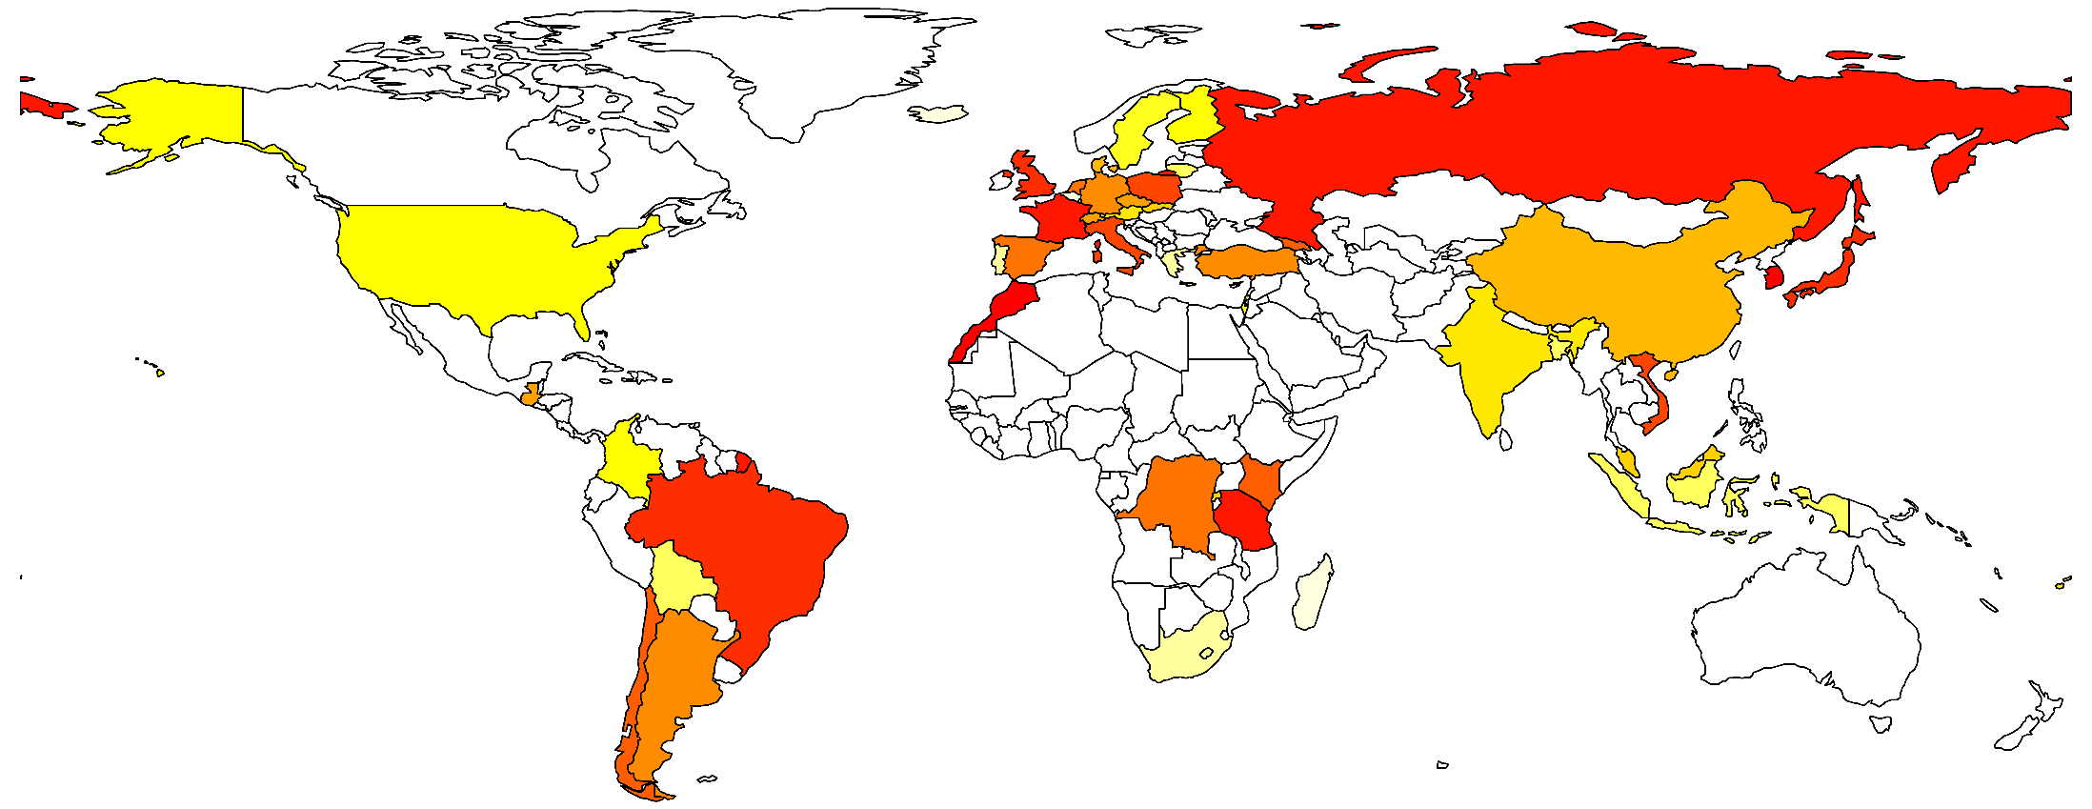
FFH experiments have been conducted with more than 44000 subjects around the world.
The figure depicts the average standardized report per country. The darker the color, the higher the average report. White means that we don’t have data from this country.

Slide 5
The “standardized report” allows comparing behavior across studies.
Define a standardized report as follows:
If a subject’s report leads to the lowest possible payoff, the standardized report is −1
If the report leads to the highest possible payoff, it is +1
If the report leads to the same payoff as the expected payoff from truthful reporting, the standardized report is 0
Payoffs in-between are linearly filled in

Slide 6
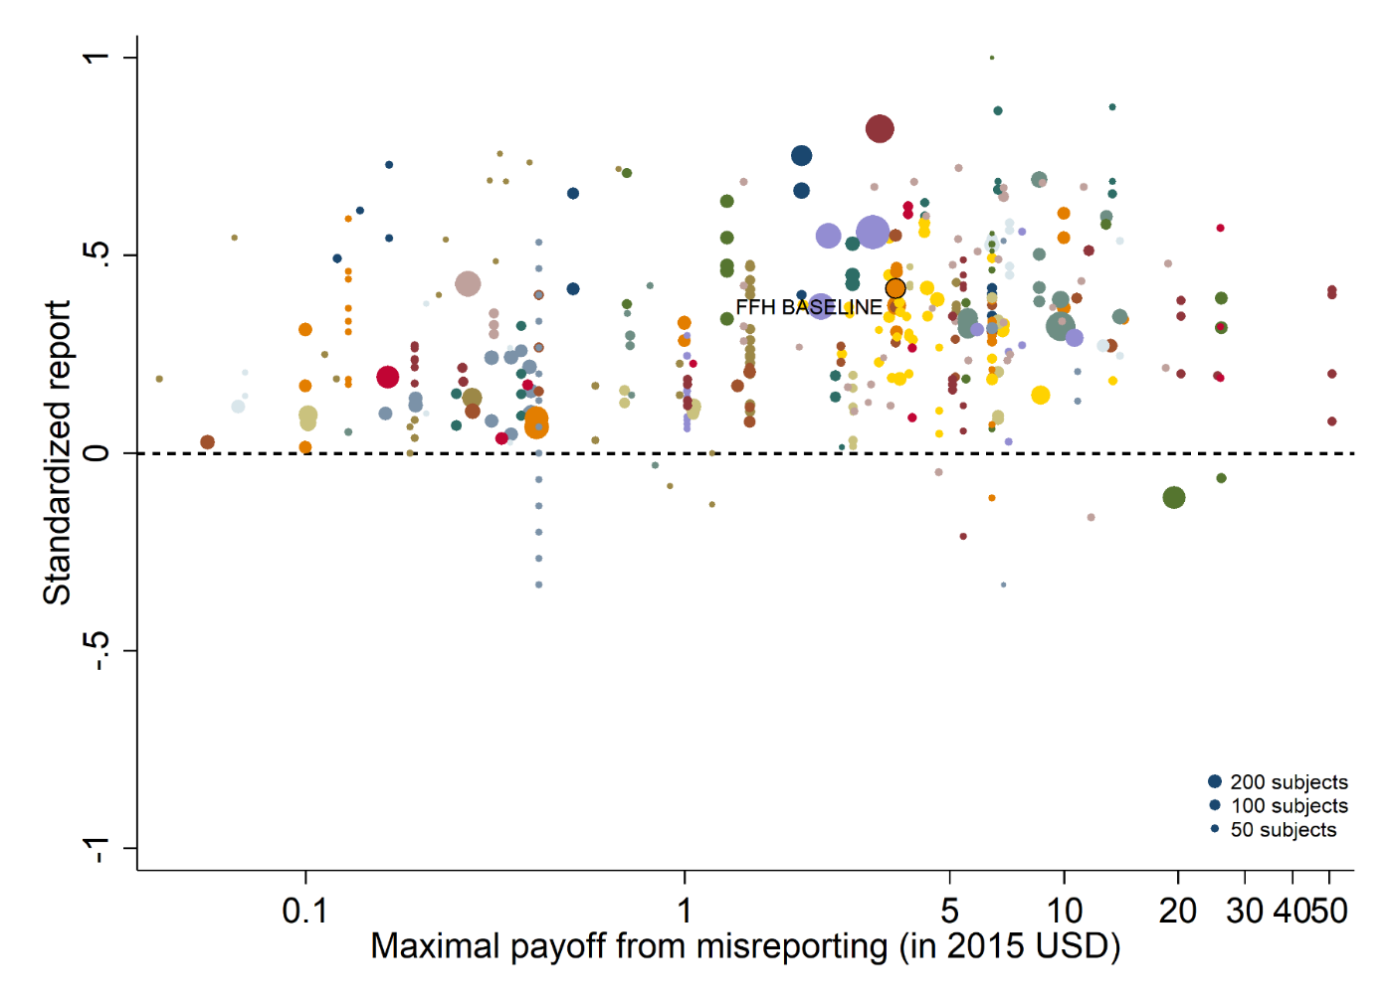
Only 23% of possible monetary gain is realized (cf. dictator game).
The figure plots standardized report against maximal payoff from misreporting. Standardized report is on the y-axis. A value of 0 means that subjects realize as much payoff as a group of subjects who all tell the truth. A value of 1 means that subjects all report the state that yields the highest payoff. The maximal payoff from misreporting (converted by PPP to 2015 USD) is the difference between the highest and lowest possible payoff from reporting. Each bubble represents the average standardized report of one treatment and the size of a bubble is proportional to the number of subjects in that treatment. “FFH BASELINE” marks the result of the baseline treatment of Fischbacher and Föllmi-Heusi (2013).

Slide 7
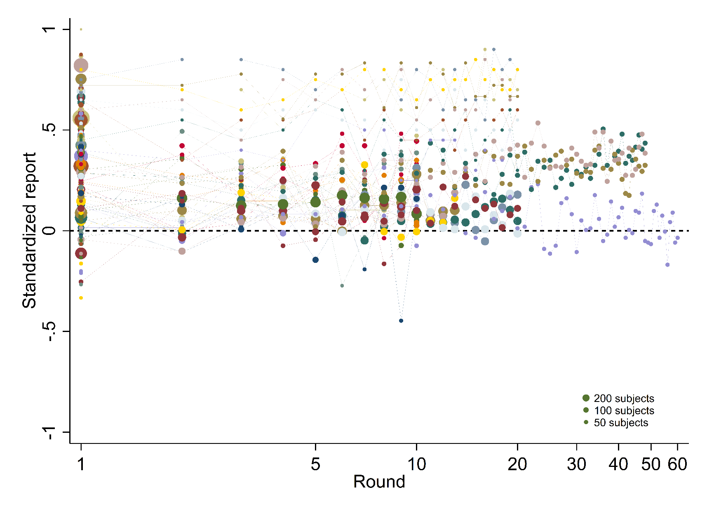
Reporting behavior does not change with repetition (cf. public goods games).
The figure plots standardized report over the rounds in the experiment. Standardized report is on the y-axis. A value of 0 means that subjects realize as much payoff as a group of subjects who all tell the truth. A value of 1 means that subjects all report the state that yields the highest payoff. The round of the experiment is on the x-axis. One-shot experiments are shown as round 1. Each bubble represents the average standardized report of one treatment in a given round and the size of a bubble is proportional to the number of subjects in that treatment.

Slide 8
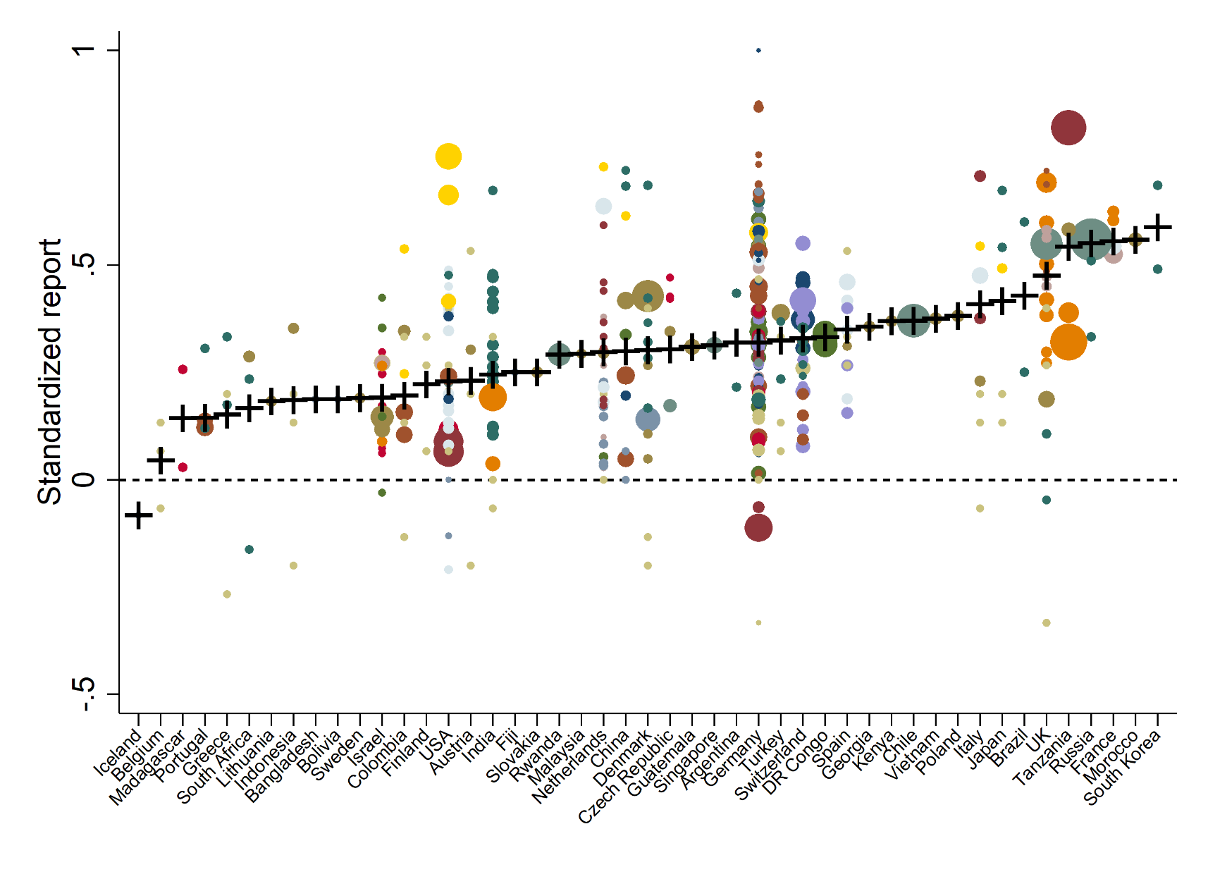
Behavior is quite stable across countries.
The figure plots standardized report against country. Standardized report is on the y-axis. A value of 0 means that subjects realize as much payoff as a group of subjects who all tell the truth. A value of 1 means that subjects all report the state that yields the highest payoff. Each bubble represents the average standardized report of one treatment and the size of a bubble is proportional to the number of subjects in that treatment. The cross is the average per country.

Slide 9
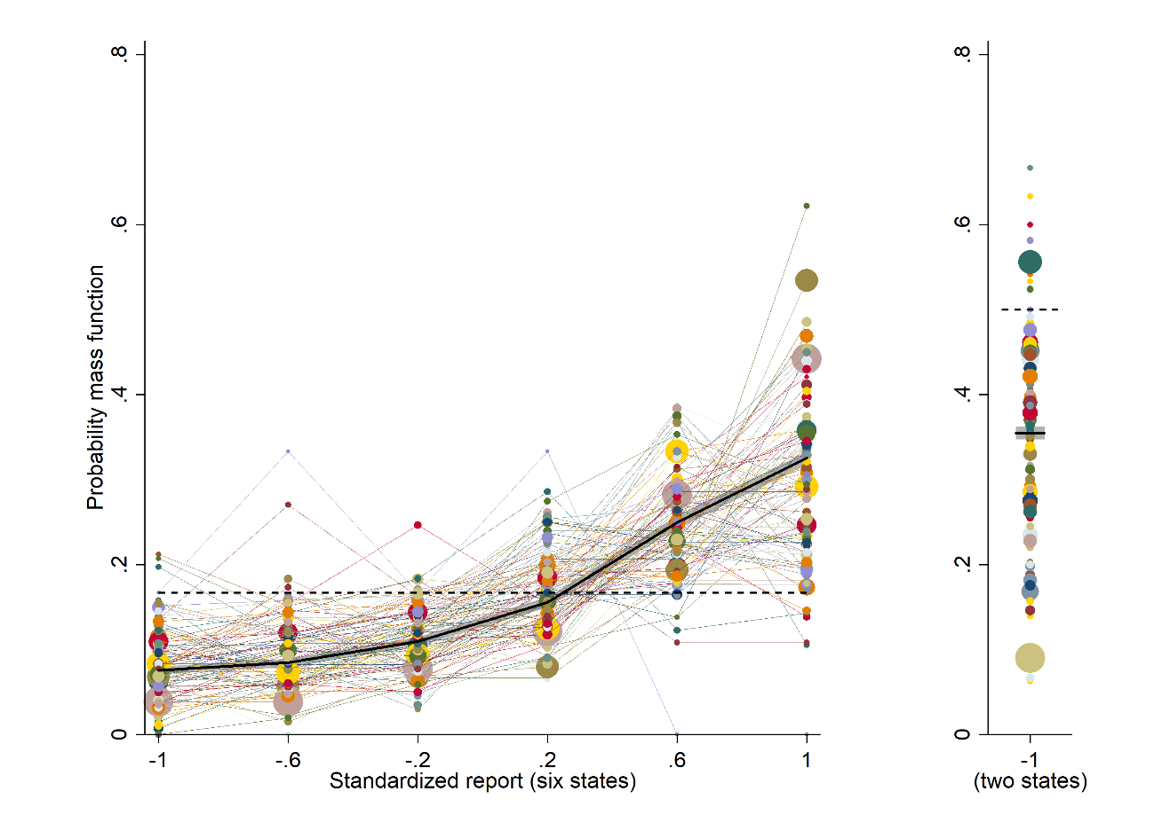
In each treatment, more than one state is reported with positive probability.
The figure depicts the distribution of reports by treatment. The left panel shows treatments that use a uniform distribution with six states and linear payoff increases. The right panel shows treatments that use a uniform distribution with two states. The right panel only depicts the likelihood that the low-payoff state is reported. The likelihood of the high-payoff state is 1 minus the depicted likelihood. The size of a bubble is proportional to the total number of subjects in that treatment. Only treatments with at least 10 observations are included. The dashed line indicates the truthful distribution at 1/6 and 1/2. The bold line is the average across all treatments, the grey area around it the 95% confidence interval of the average.

Slide 10
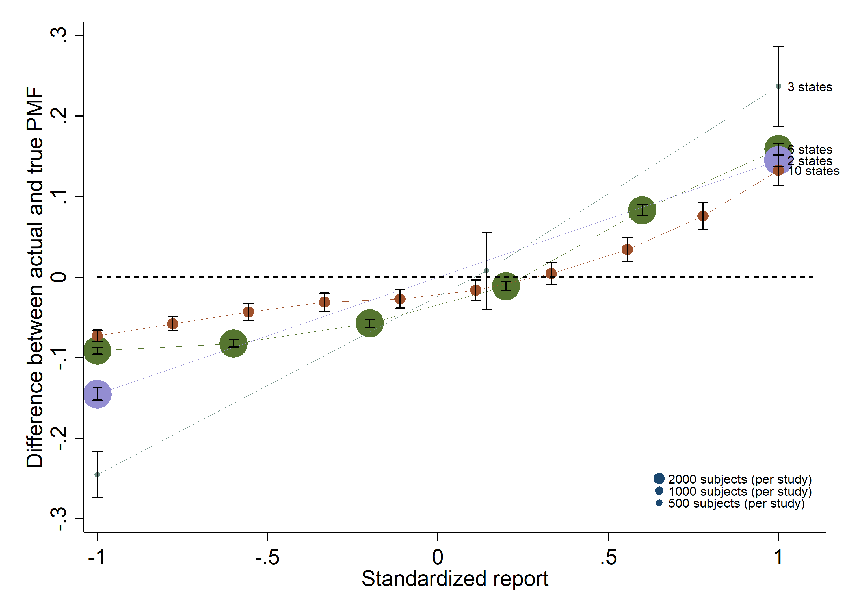
Increasing histograms of reports (for uniform distributions).
The figure depicts the difference between the actual and the truthful distribution of reports for treatments that use a uniform true distribution and linear payoff increases. Treatments are collapsed by the number of states, 2, 3, 6, or 10. The dashed line at 0 indicates the truthful distribution. The size of a bubble is proportional to the number of subjects in the treatments with a given number of states.

Slide 11
Over-reporting of non-maximal states if there are more than three states.
The figure depicts the difference between the actual and the truthful distribution of reports for treatments that use a uniform true distribution and linear payoff increases. Treatments are collapsed by the number of states, 2, 3, 6, or 10. The dashed line at 0 indicates the truthful distribution. The size of a bubble is proportional to the number of subjects in the treatments with a given number of states.

Slide 12
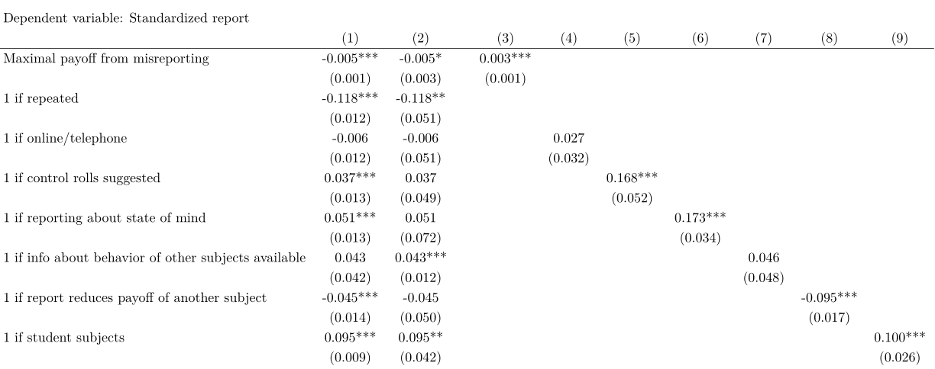
Students lie more. Online/telephone experiments yield similar behavior to direct interaction.
OLS regressions. Robust standard errors clustered on individual subjects (on studies in column 2) are in parentheses. The sample in columns 3 to 9 is restricted to those studies in which the independent variable of interest varies. Maximal payoff from misreporting is the difference of the highest and lowest potential payoff (converted by PPP to 2015 USD).

Slide 13
One can use two sources of variation to identify effects and to investigate publication bias.
Use within-study variation (columns 3-8)
Clean randomization into treatments
But prone to publication bias
Use across-study variation (columns 1-2)
Has to rely on conditional independence assumption
But less affected by publication bias
Effects in columns 3-8 (within-study variation) usually larger than in columns 1-2
In line with important effect of publication bias

Slide 14
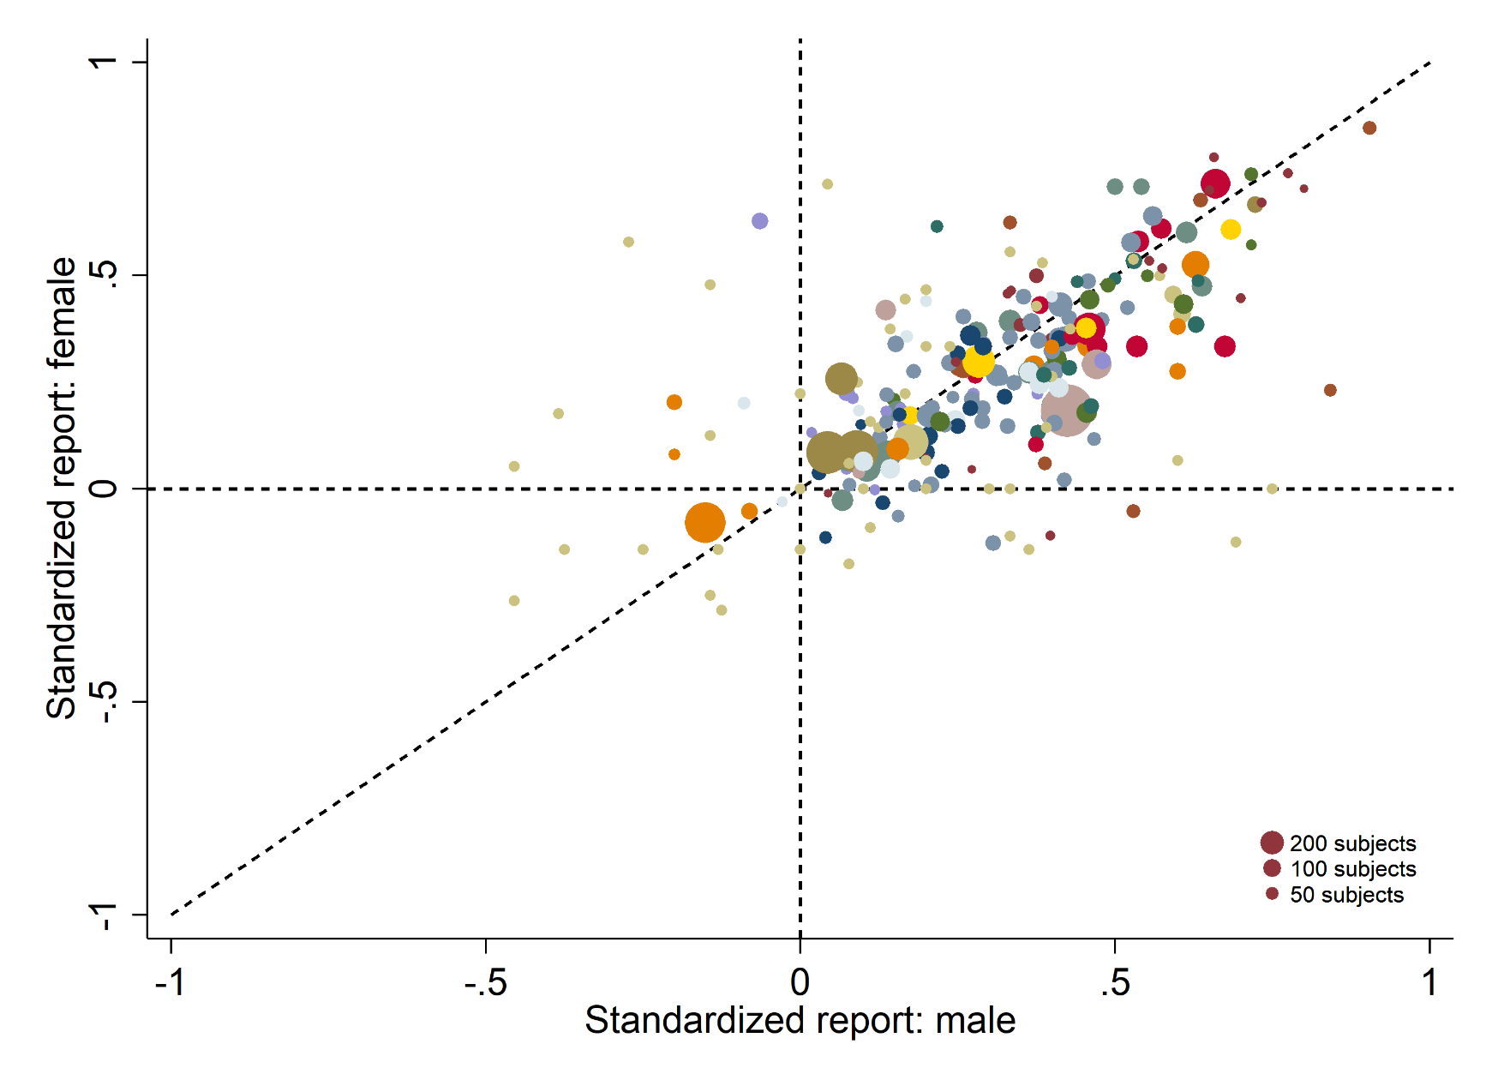
Men lie more than women.
The figure plots the average standardized report of male subjects (x-axis) vs. the average standardized report by female subjects (y-axis). A standardized report of 0 means that subjects realize as much payoff as a group of subjects who all tell the truth. A value of 1 means that subjects all report the state that yields the highest payoff. Data is restricted to those treatments where male and female subjects participated. The size of a bubble is proportional to the number of subjects in that treatment.

Slide 15
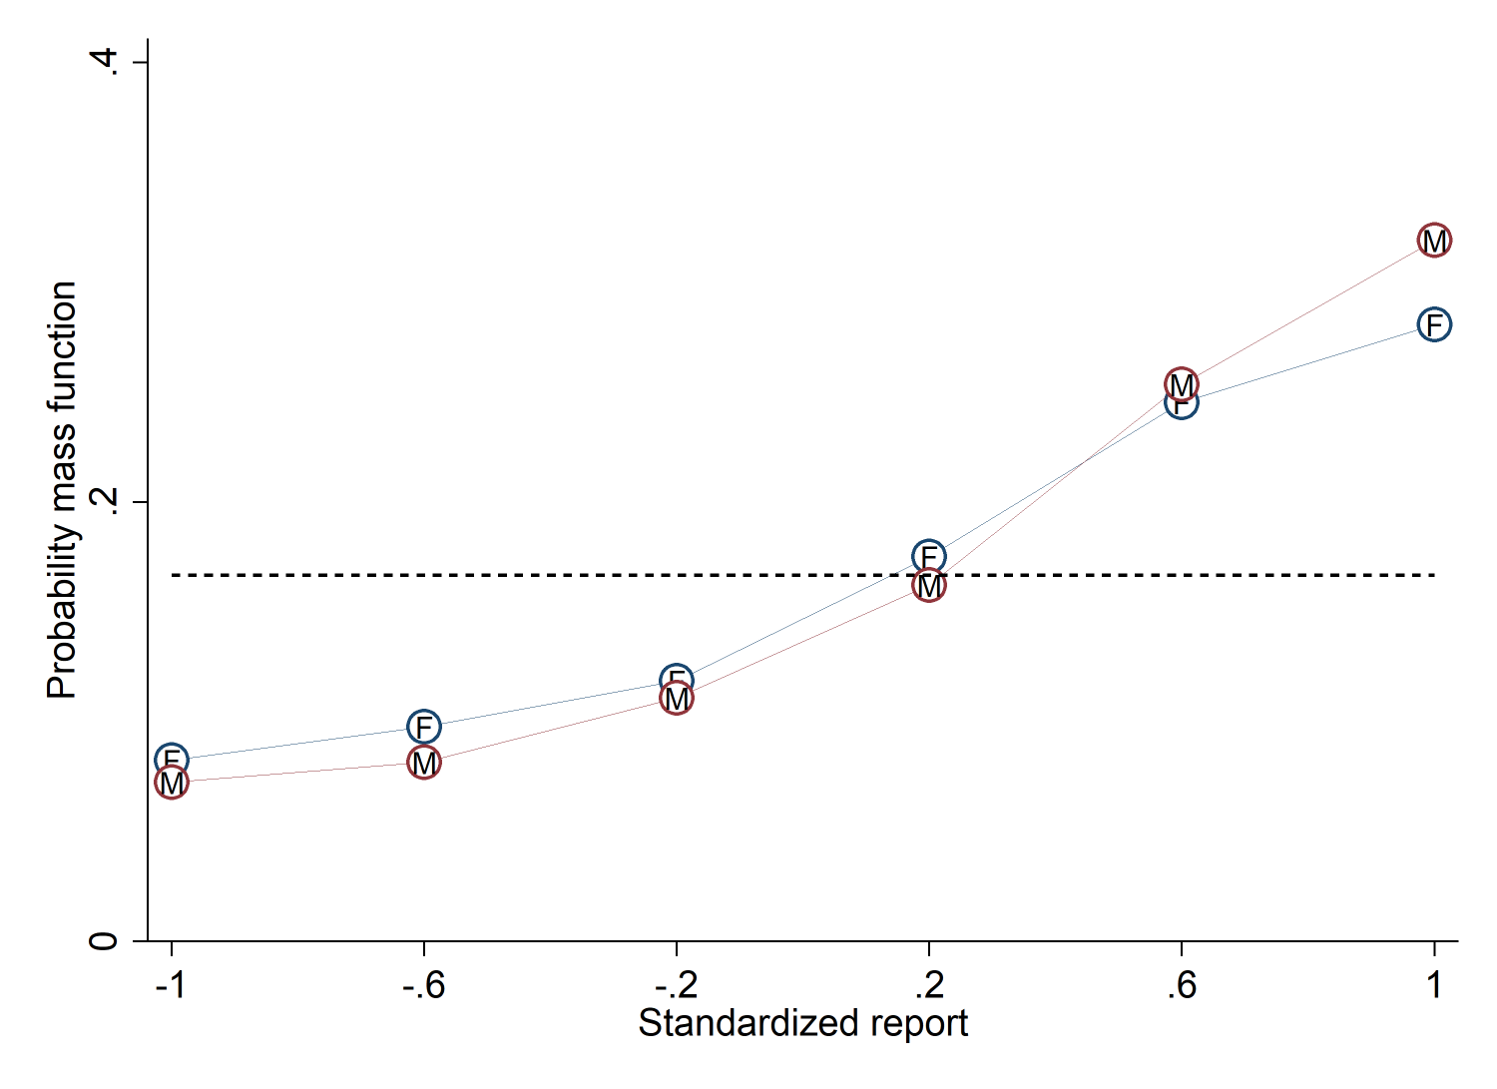
Men lie more than women.
The figure depicts the distribution of reports for treatments that use a uniform distribution with six states and linear payoff increases, collapsed by gender. The line marked “F” is the distribution of female subjects and the line marked “M” is the distribution of male subjects. The dashed line indicates the truthful distribution at 1/6.

Slide 16
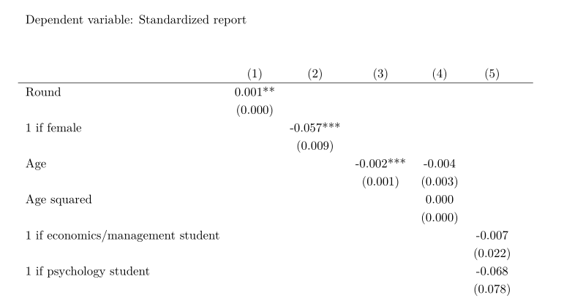
Older people lie less. Field of study is not correlated with reporting.
OLS regressions. Robust standard errors clustered on individual subjects are in parentheses. The sample in each specification is restricted to those treatments in which the independent variable(s) vary.

Slide 17
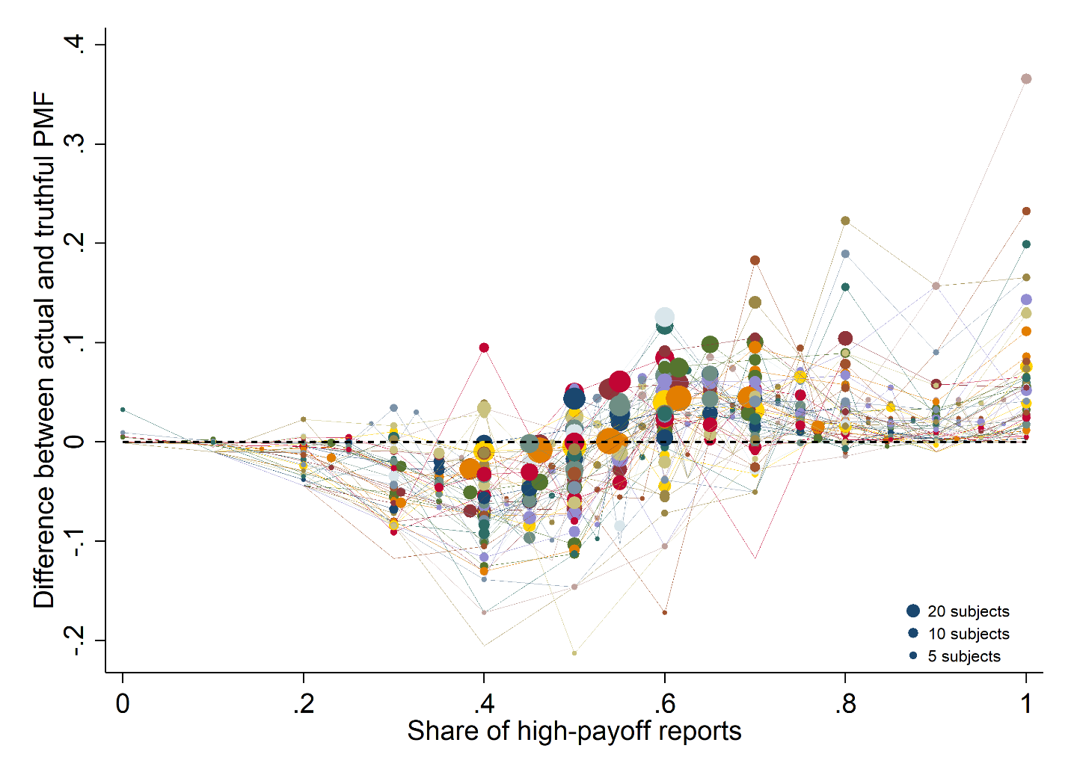
Less than 4 percent of subjects act according to standard theory.
The figure displays the distribution of the sum of standardized reports in experiments in which subjects repeatedly report the state of a uniform distribution with two states. Each line represents one treatment. The share of the potential high-payoff reports is on the x-axis. On the y-axis is the difference between the actual and the truthful probability mass function. The size of a bubble is proportional to the number of subjects in a given treatment at this share of high-payoff reports.

